Slide 1
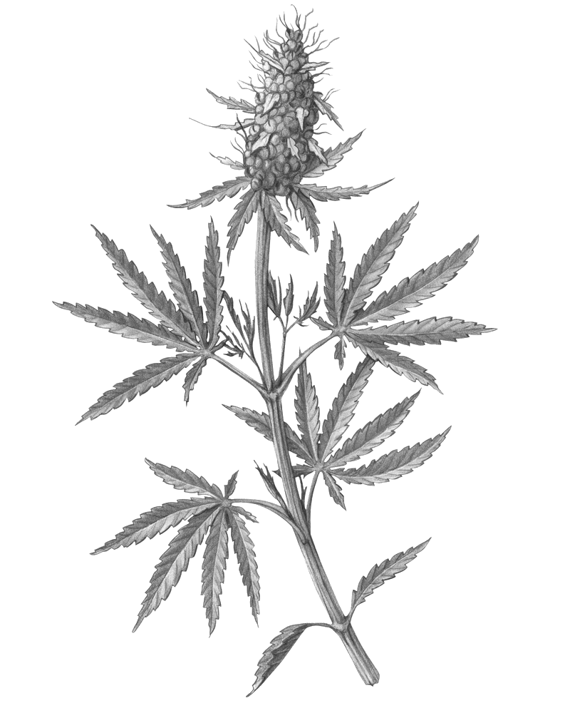

Whole Flower Category Analysis
By velvet Management

Slide 2
Data Sources
Sales Data acquired from EZ Focus last updated at the end of July
Data has been filtered to remove products with zero sales in the last 6 months
Distribution data acquired from Trellis – August 28th
Distribution for full category omitted SKUs with less than 10 points of distribution

Slide 3
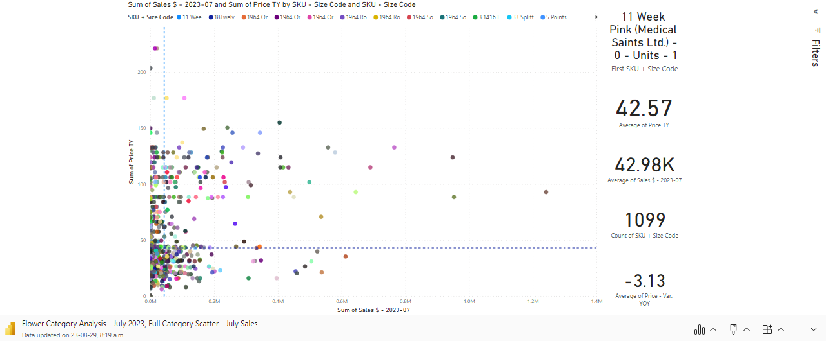
Category Overview: Landscape by SKU – Price vs. July Sales

Slide 4
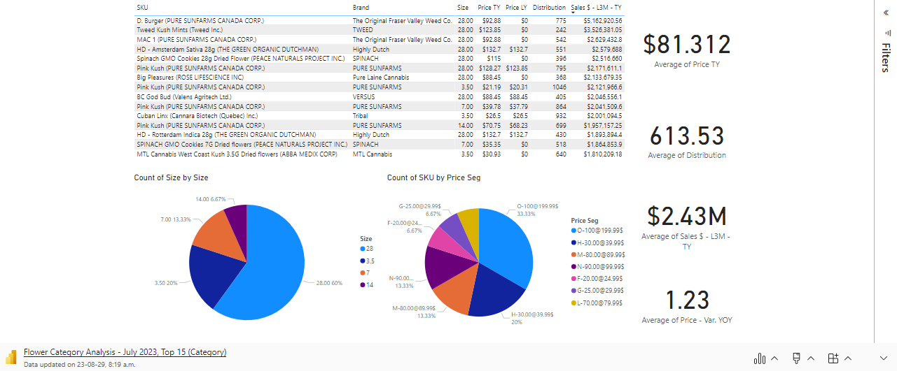
Category Overview: Top 15 SKUs by Sales $ - L3M

Slide 5
Whole Flower Overview: Benchmarks
Whole Flower is a vast category with 1099 Active SKUs (at least 1 unit sales in the last 6 months).
Average SKU in the category is priced at $42.57 while the average SKU in the Top 15 selling SKUs is $81.31
Skewed by the Top 15 being dominated by (28g) SKUs – 60% of the Top 15
Average price in the category compressed by -$3.13, while average price increased in the Top 15 SKUs by $1.23
Average SKU in the category captured $42k of sales in July while average in the Top 15 captured $2.43m
Category revenue is dominated by (3.5g) capturing 37.8% of sales $ and (28g) with 36.9% of sales $
Top 15 SKUs collected 21.34% of sales $ in July
Average distribution across the category was 118 points
Top 15 SKUs average distribution was 614 points

Slide 6
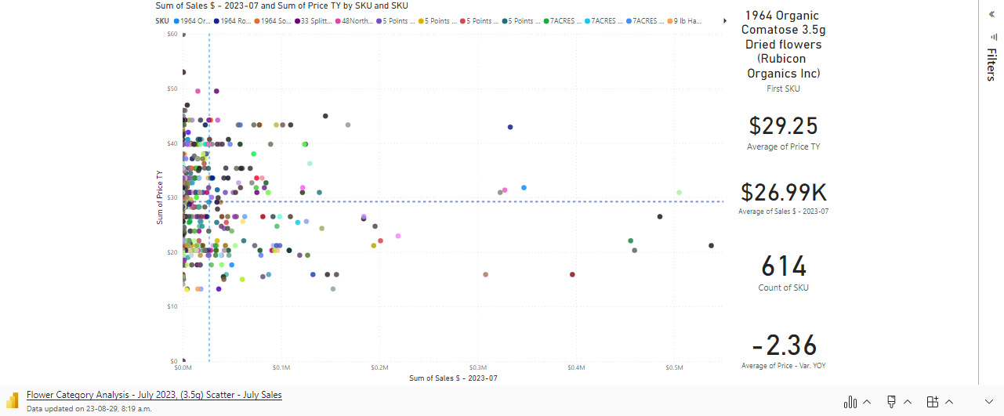
(3.5g) Overview: Landscape by SKU

Slide 7
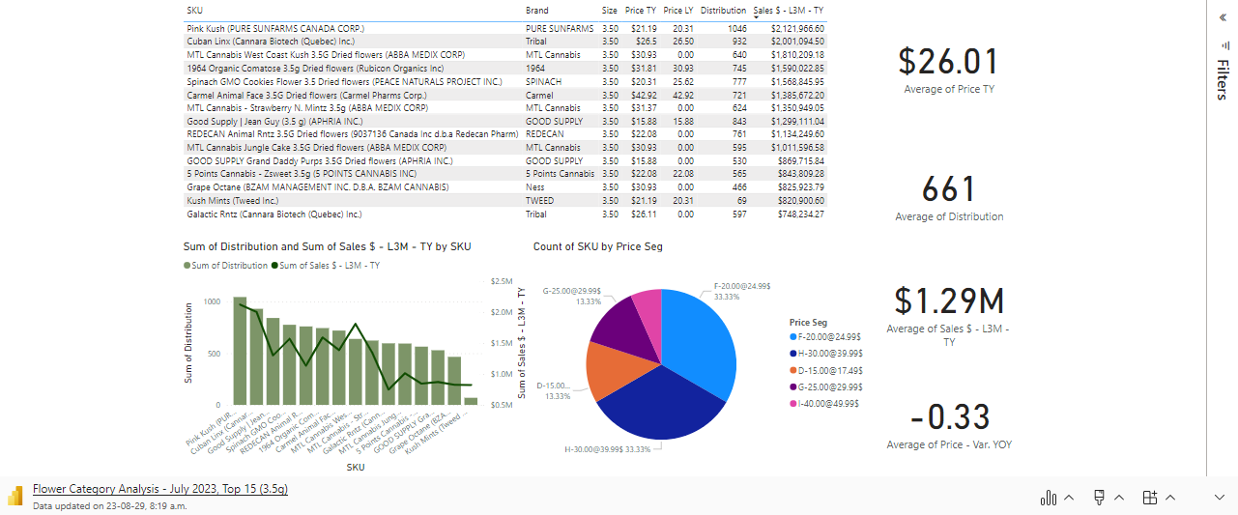
(3.5g) Overview: Top 15 SKUs

Slide 8
(3.5g) Overview: Benchmarks
(3.5g) is the largest format segment in the category by Sales $ with 614 Active SKUs
Average (3.5g) is priced at $29.25
Average in the Top 15 SKUs is -$3.24 lower than the category average
Average SKU experienced -$2.36 price compression while the Top 15 experienced less downward pressure (-$0.33)
Average SKU captured $26.99k sales $ in July
Average SKU in Top 15 SKUs captured $1.29m
Average (3.5g) distribution is 115 points
Average in the Top 15 is 661 points
Top 15 SKUs captured 31.4% of all (3.5g) sales $

Slide 9
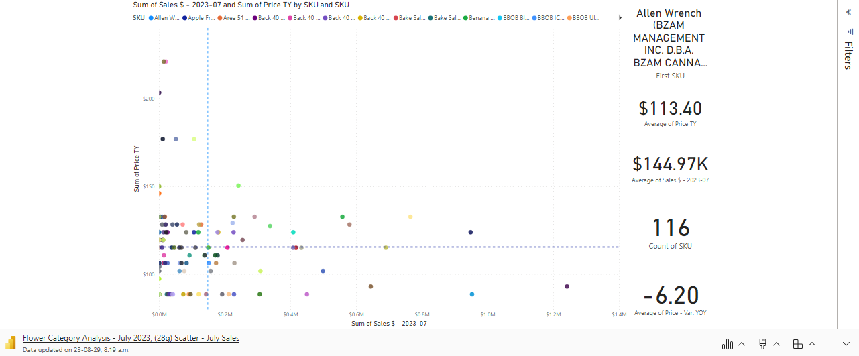
(28g) Overview: Landscape by SKU

Slide 10
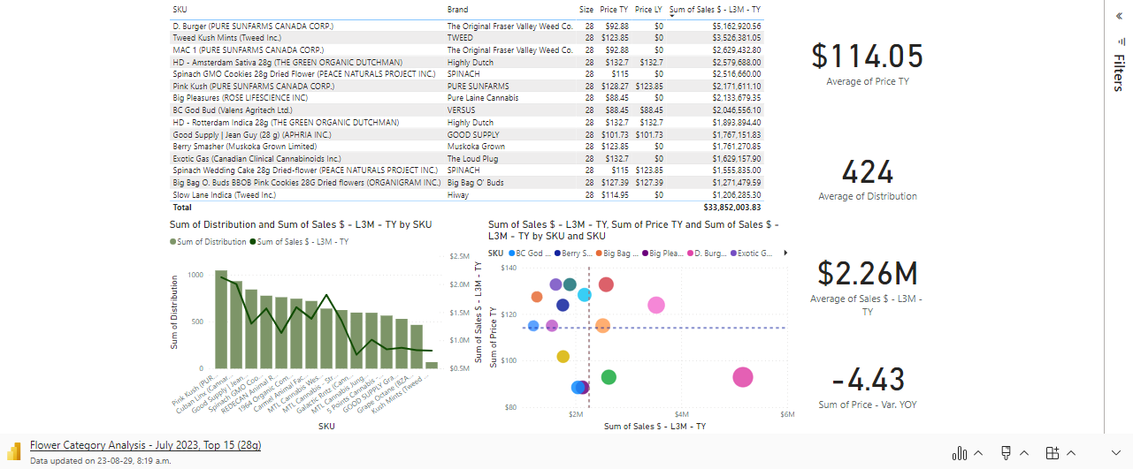
(28g) Overview: Top 15 SKUs

Slide 11
(28g) Overview: Benchmarks
(28g) is the second largest format segment in the category by Sales $ with 116 Active SKUs
Average (28g) is priced at $113.40
Average in the Top 15 SKUs is $0.65 higher than the category average @ $114.05
Average SKU experienced -$6.20 price compression
Top 15 SKUs experienced slightly less downward pressure (-$4.43)
Average SKU captured $144.97k sales $ in July
Average SKU in Top 15 SKUs captured $2.26m
Average (3.5g) distribution is 113 points
Average in the Top 15 is 424 points
Top 15 SKUs captured 54.74% of (28g) sales

Slide 12
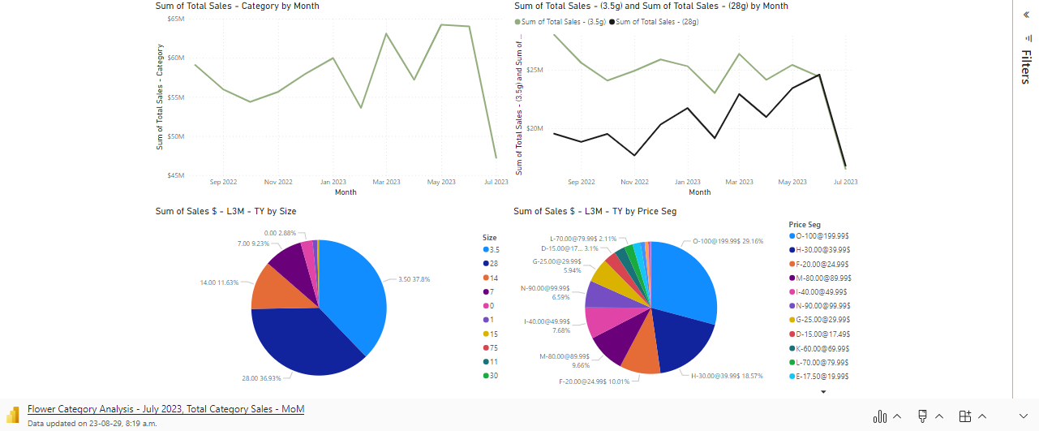
Sales Trends

Slide 13
Category Overview: Insights
Lots of new SKUs reaching the top sales spots in every corner of the category – Innovation is Key!
7 of the Top 15 SKUs have been active for less than 1 year
7 of the Top 15 (3.5g) SKUs are active >1 year & 8 of the Top 15 (28g)
Consumers are willing to pay a little more when buying in bulk
(28g) was the only format segment where the Top 15 SKUs held a higher average priced than the full segment
(3.5g) is an over saturated segment with the large majority of SKUs in the category (614 of 1099)
(28g) segment presents opportunity to grab market share with a significantly lower SKU count (116 of 1099)
Majority of sales is captured by Top 15 SKUs (54%) which is less pronounced in other segments, suggesting possibility for disruption

Slide 14
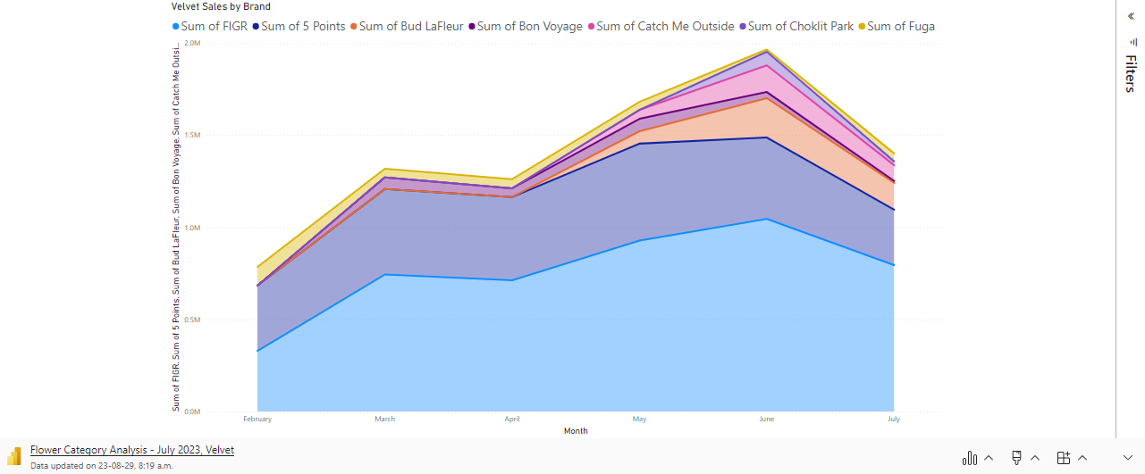
Velvet whole Flower Sales – Last 6 Months by Brand

Slide 15
Velvet Overview: Insights
Sales are only for whole flower in our currently active portfolio
Velvet has captured an average 2.94% of Flower sales in L3M
Sales are dominated by FIGR followed by 5 Points with Bud Lafleur growing rapidly
Month | Total Sales - Category | Velvet Sales | Velvet $ Share
07/2023 | $47,231,932.04 | $1,427,155.18 | 3.02%
06/2023 | $64,058,057.69 | $2,001,424.19 | 3.12%
05/2023 | $64,253,249.04 | $1,724,280.90 | 2.68%
04/2023 | $57,220,069.62 | $1,283,579.98 | 2.24%
03/2023 | $63,118,841.01 | $1,346,913.38 | 2.13%
02/2023 | $53,615,919.07 | $860,800.20 | 1.61%
01/2023 | $59,994,517.99 | $810,476.66 | 1.35%
12/2022 | $57,947,944.98 | $578,858.83 | 1.00%
11/2022 | $55,661,629.57 | $750,666.07 | 1.35%
10/2022 | $54,386,110.34 | $878,796.37 | 1.62%
09/2022 | $55,985,668.06 | $993,262.33 | 1.77%
08/2022 | $59,101,494.47 | $985,017.17 | 1.67%

Slide 16
Velvet Overview: Benchmarking other Agencies
Month | Total Sales - Category | Velvet Sales | Velvet $ Share | Kindred Sales | Kindred $ Share | Cannavolve Sales | Cannavolve $ Share
07/2023 | $47,231,932.04 | $1,427,155.18 | 3.02% | $347,284.55 | 0.74% | $1,052,928.87 | 2.23%
06/2023 | $64,058,057.69 | $2,001,424.19 | 3.12% | $648,587.01 | 1.01% | $1,481,236.76 | 2.31%
05/2023 | $64,253,249.04 | $1,724,280.90 | 2.68% | $729,419.61 | 1.14% | $1,535,281.72 | 2.39%
04/2023 | $57,220,069.62 | $1,283,579.98 | 2.24% | $372,572.68 | 0.65% | $1,197,481.32 | 2.09%
03/2023 | $63,118,841.01 | $1,346,913.38 | 2.13% | $545,862.21 | 0.86% | $1,330,741.69 | 2.11%
02/2023 | $53,615,919.07 | $860,800.20 | 1.61% | $259,715.90 | 0.48% | $1,158,034.45 | 2.16%
01/2023 | $59,994,517.99 | $810,476.66 | 1.35% | $180,433.96 | 0.30% | $1,111,891.95 | 1.85%
12/2022 | $57,947,944.98 | $578,858.83 | 1.00% | $137,211.24 | 0.24% | $656,834.52 | 1.13%
11/2022 | $55,661,629.57 | $750,666.07 | 1.35% | $154,547.86 | 0.28% | $666,338.57 | 1.20%
10/2022 | $54,386,110.34 | $878,796.37 | 1.62% | $236,040.63 | 0.43% | $698,986.83 | 1.29%
09/2022 | $55,985,668.06 | $993,262.33 | 1.77% | $241,413.98 | 0.43% | $545,913.95 | 0.98%
08/2022 | $59,101,494.47 | $985,017.17 | 1.67% | $281,324.93 | 0.48% | $814,128.98 | 1.38%
Velvet is performing well in the whole flower category compared to other agencies with significant growth in the last 6 months following the launch of many new SKUs
Should be taken with a grain of salt as EZFocus data is iffy with other agencies SKUs

